Slide 1
TEST CONFIGURATION

Slide 2
Laboratory tests
Different medical systems have distinct stages and processes of conducting medical test. This document will track the life cycle of a medical test on-board iBLIS.
After receiving test request from a patient or other embedded systems the immediate step is to book for the test via the laboratory system. The initial stage of capturing the test details is most important stage. In essence, accurate data capturing will streamline the logical steps to ensure that what you test is what you meant to test, and that the final test report meets the client’s needs and expectations.

Slide 3
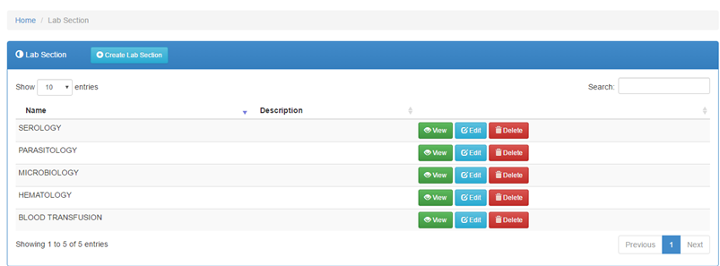
Creating a Lab Section
Click the test catalog tab, then click on the button

Slide 4

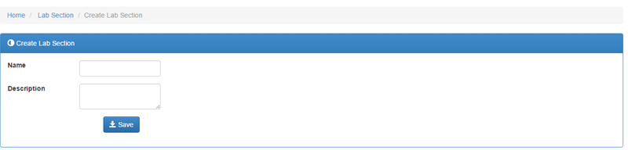
Continuation….
Fill in the various fields then click the button

Slide 5



Continuation….
1. To search a particular lab section click on the field
2. The button shows a brief description of a particular lab section
3. The button enables the details of a lab section to be changed/ edited
4. To delete a specific lab section click on the button

Slide 6
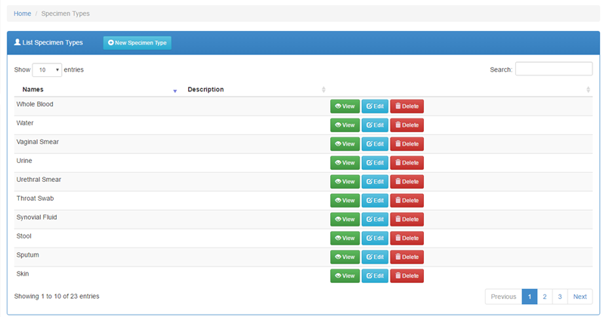
Specimen Type
To create a new specimen type, click on the button

Slide 7
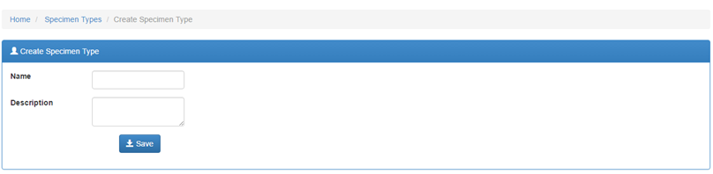
Continuation….
Fill in the name and description then click on

Slide 8

Continuation….
1. To search a particular lab section click on the field
2. The button shows a specimen type details
3. The button enables the details of a specimen type to be changed/ edited
4. To delete a specimen type click on the button

Slide 9
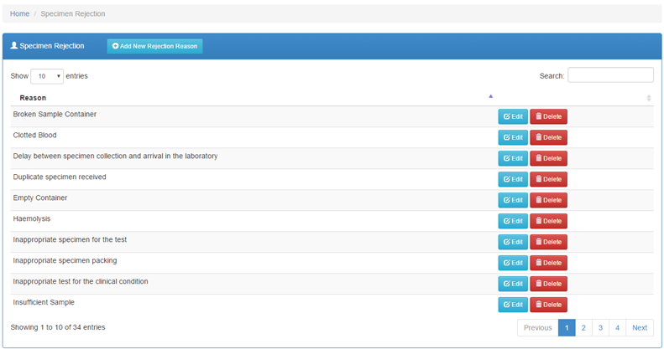
Specimen Rejection
Under the test catalog, there’s a specimen rejection tab that contains a list of specimen rejection reasons.

Slide 10

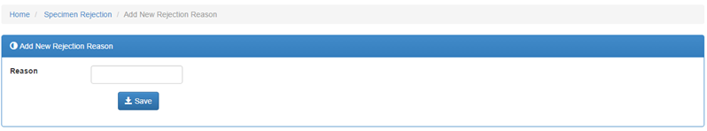
Continuation….
1. To add a new reason, click on the button then
2. To search for a particular specimen rejection reason click on the field
3. The button enables a specimen rejection reason to be changed/ edited
4. To delete a specimen rejection reason click the button

Slide 11
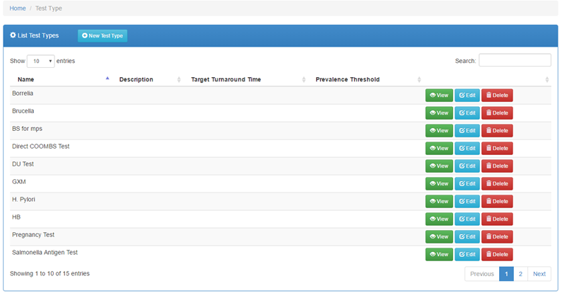
Test Types
Found under the test catalog tab

Slide 12
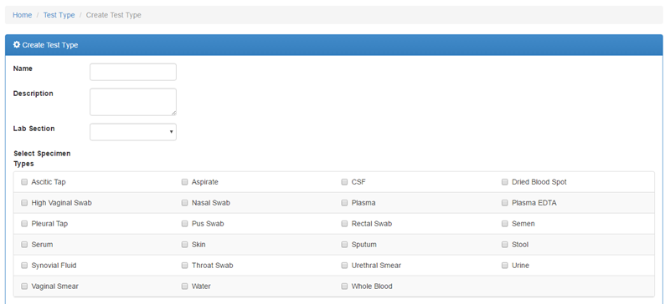
Continuation….
To add a new test type click on the button, fill in the necessary fields and select specimen types.

Slide 13
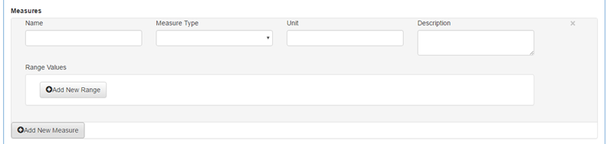
Measure Type
On the create test type page, measures can be added by clicking on the button and filling in the various fields. On the measure type tab, there’s a drop down where a range of measure types exist.

Slide 14
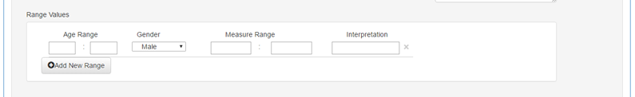
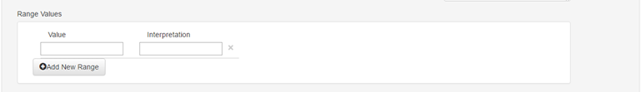
Range Value
The range values depends on the type of measure type selected.
1. Numeric range measure type
2. Alphanumeric values and autocomplete measure type

Slide 15
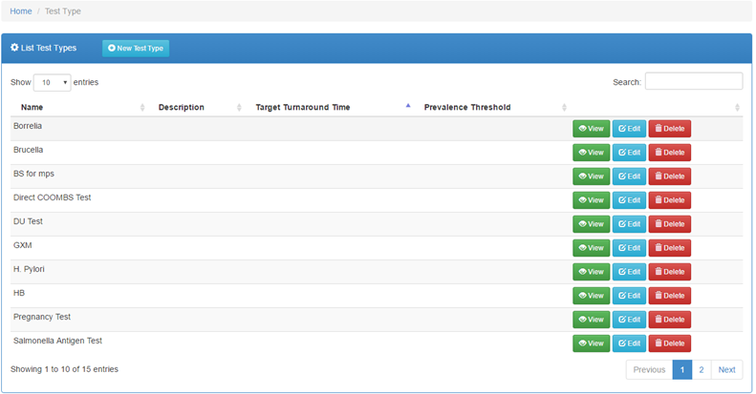
Target Turnaround Time

Slide 16
Prevalence Threshold

Slide 17
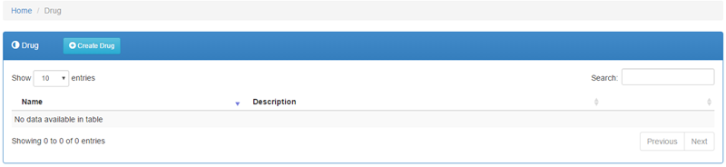
Drugs
Lists all available drugs

Slide 18
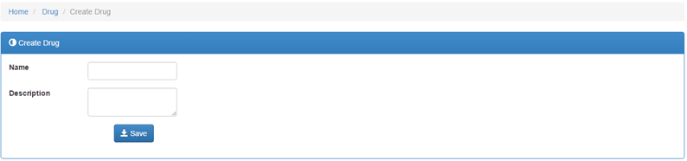
Continuation….
1. To create a drug, click on the button
Then click on the button.
2. To search a particular lab section click on the field

Slide 19
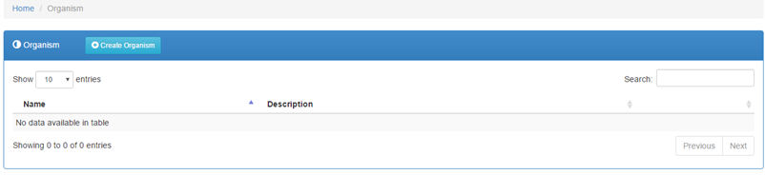
Organisms
Shows a list of existing organisms

Slide 20
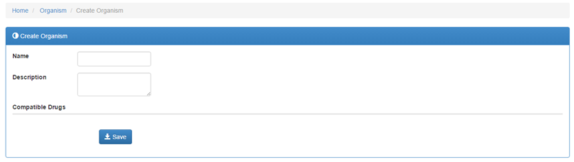
Continuation….
1. To create a drug, click on the button
Then click on the button.
2. To search a particular lab section click on the field

